Slide 1

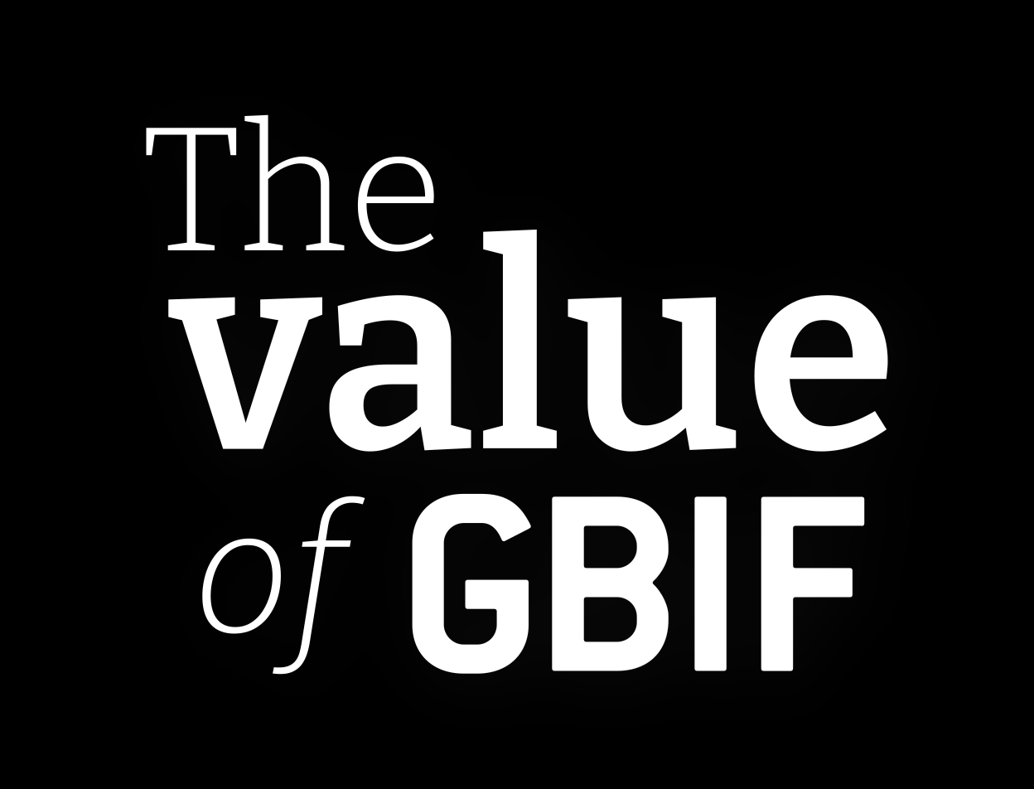

Slide 2
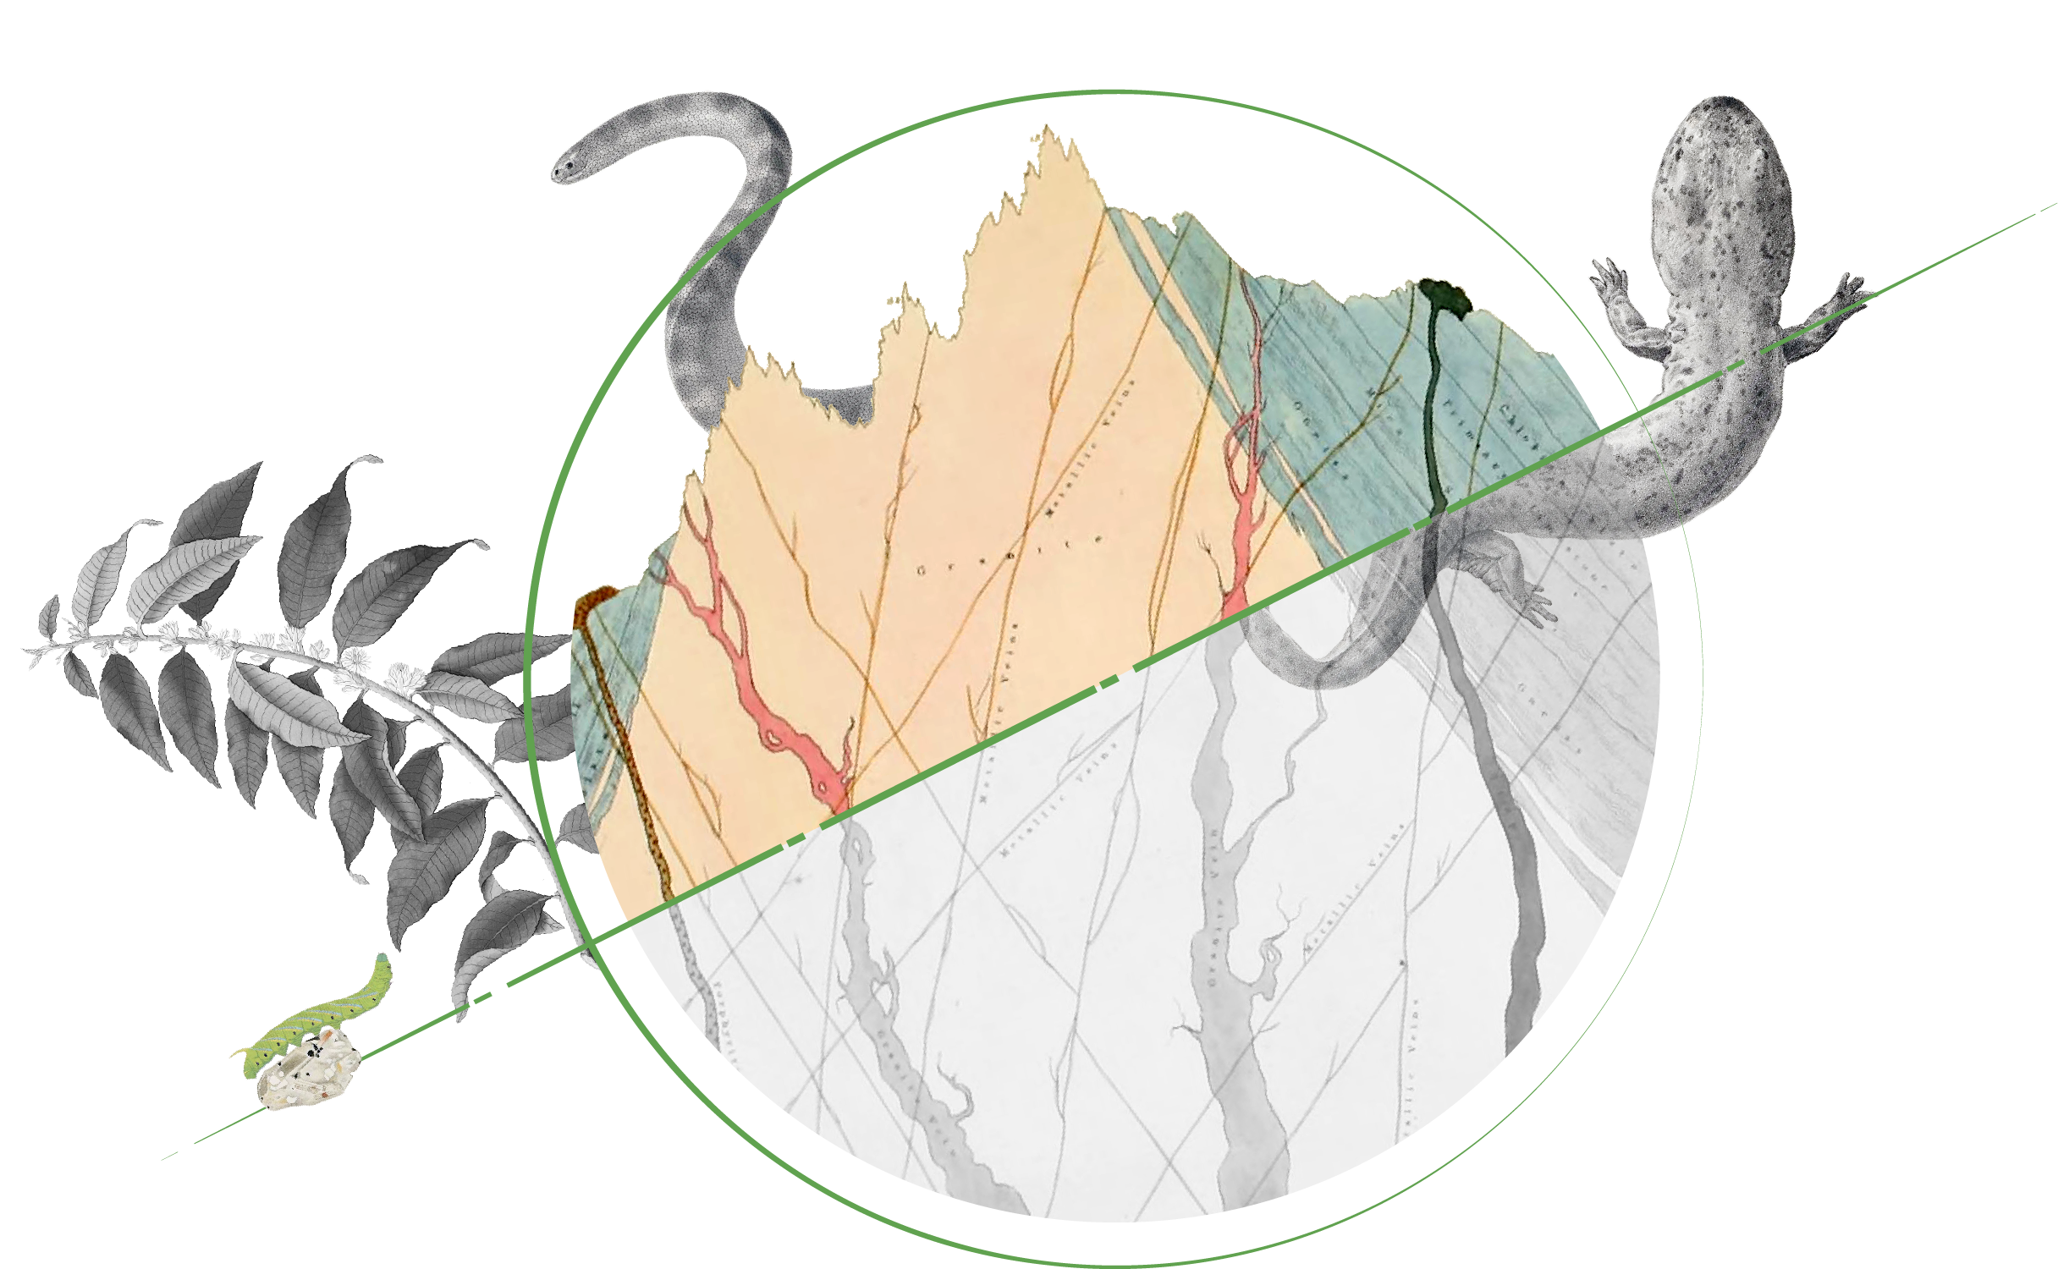
GBIF expands the scope of what is possible
Almost half of GBIF users would have found it impossible to achieve the same outcome in the absence of GBIF.

Slide 3
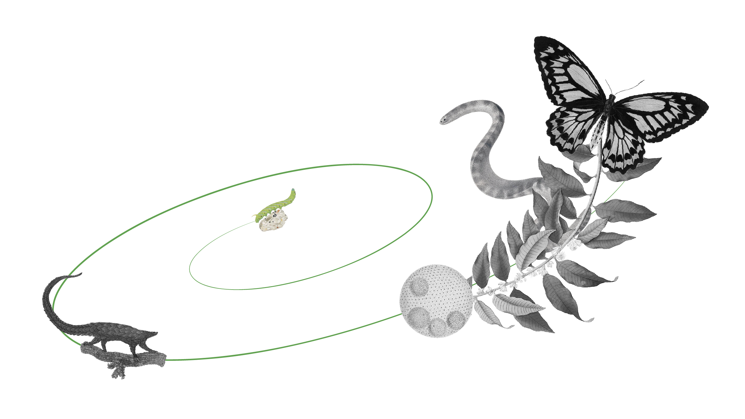
Economic dividend from GBIF-mediated data
For every €1 invested in GBIF there are €3 of benefits to users and up to €12 to society

Slide 4
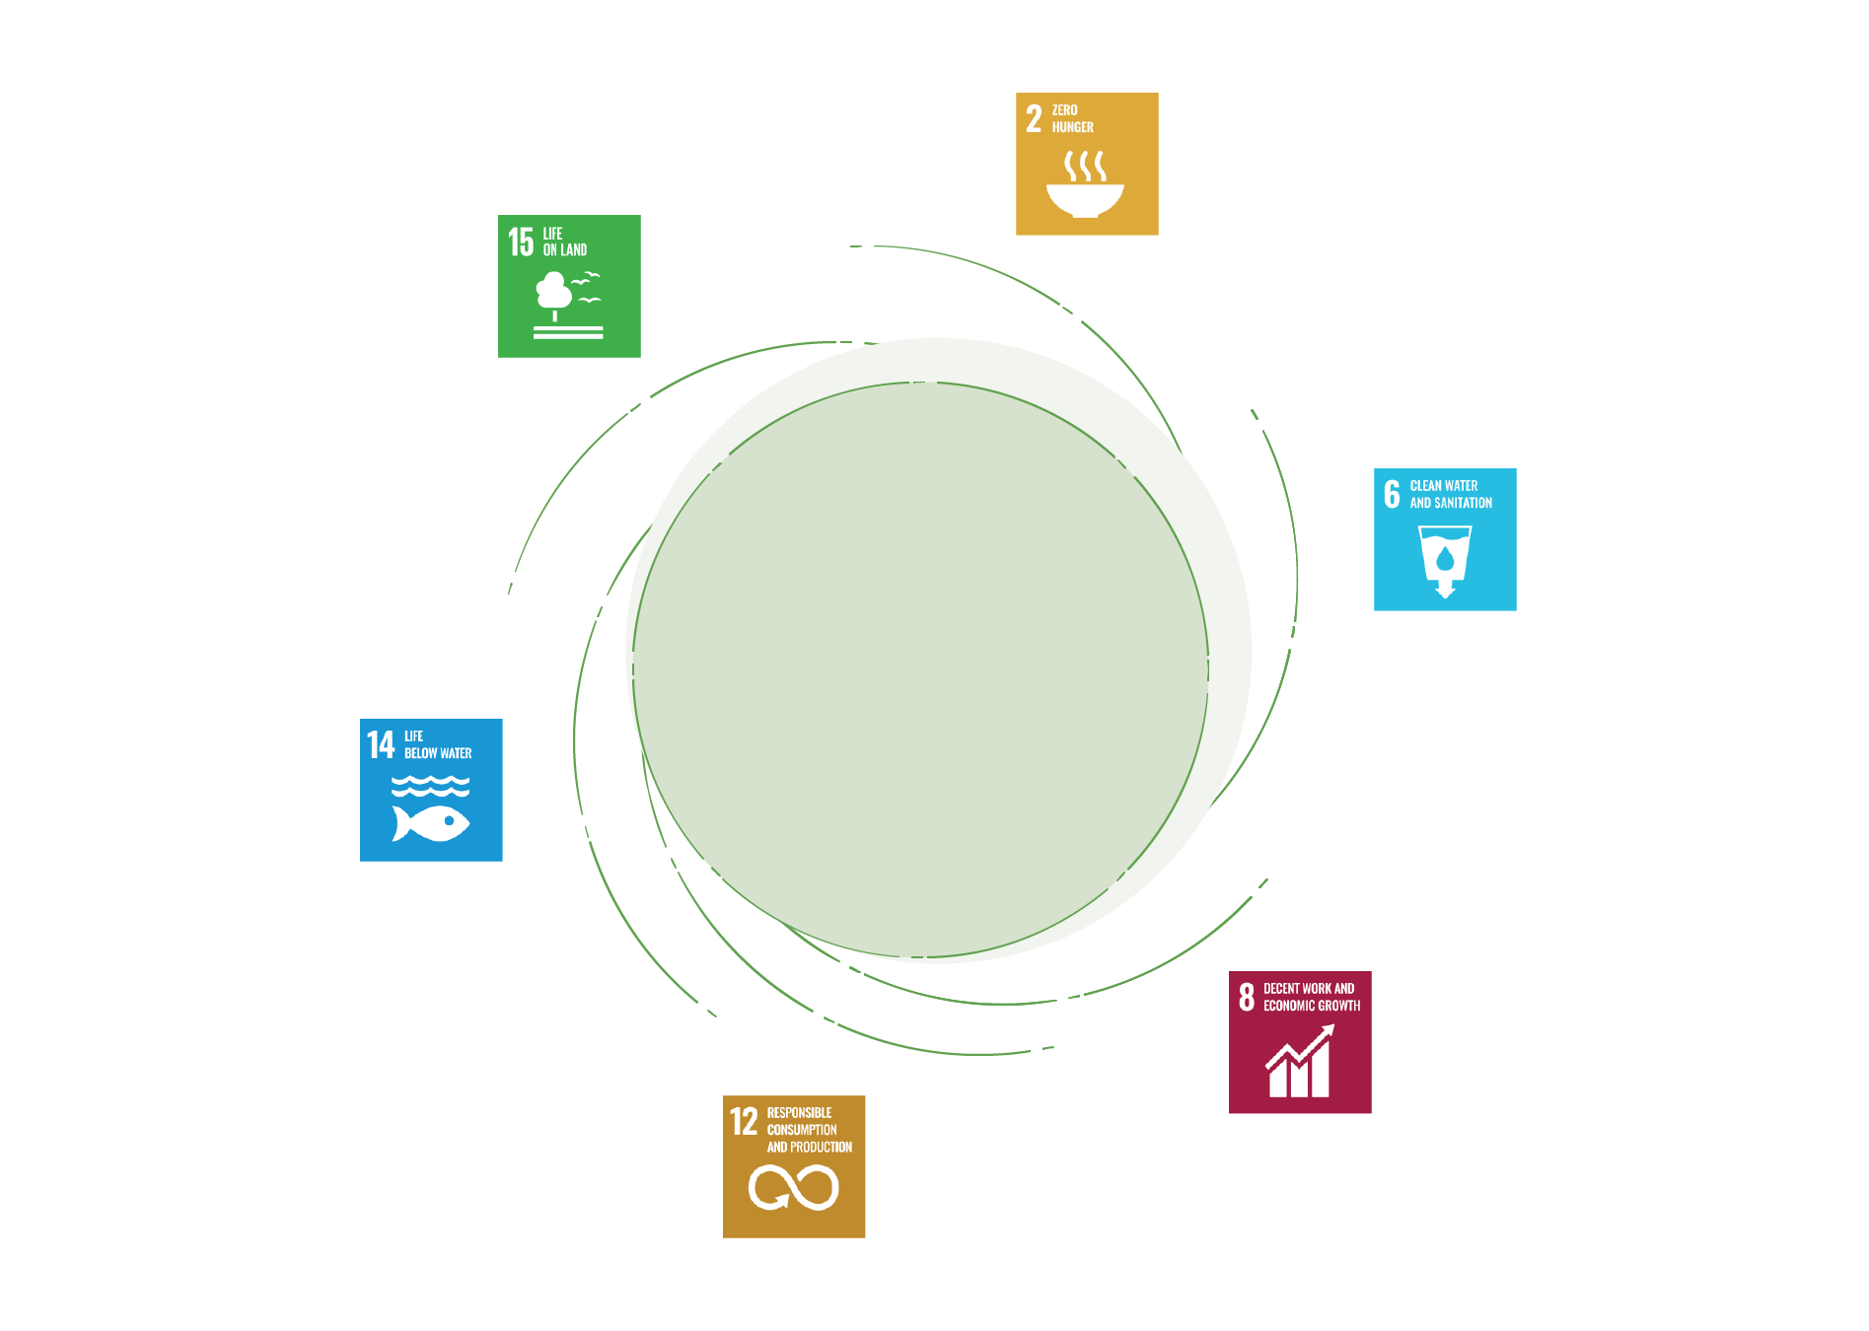
GBIF and a sustainable future
Almost all GBIF users, 92%, identified that their use of GBIF-mediated data was linked to achieving Sustainable Development Goals

Slide 5
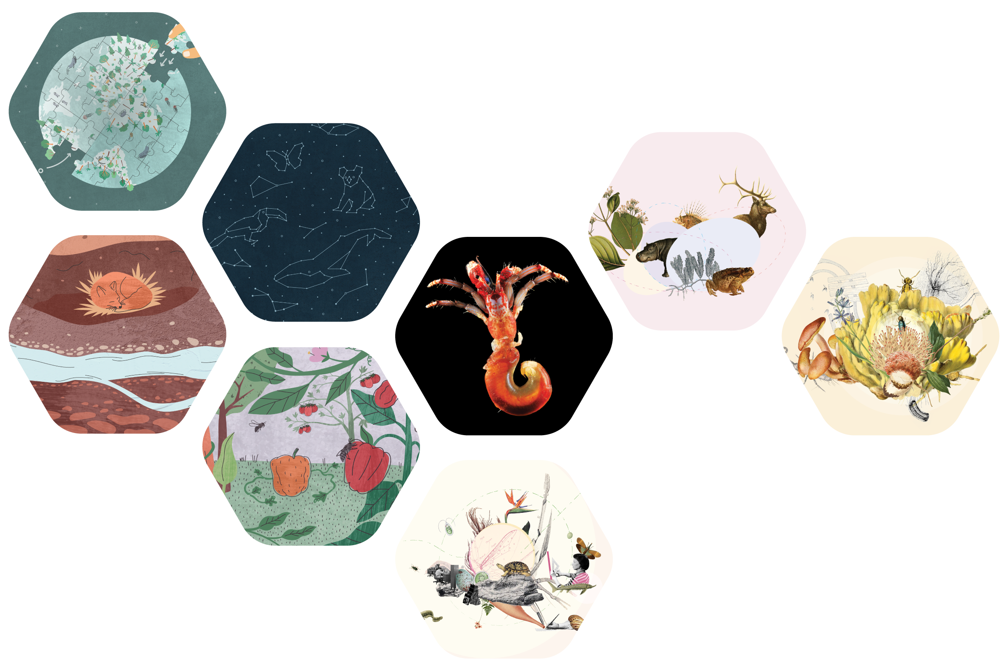
Thematic communities
Fostering focused collaboration and knowledge exchange among experts in specific biodiversity domains, these communities serve as dynamic hubs where people come together to address shared challenges.

Slide 6
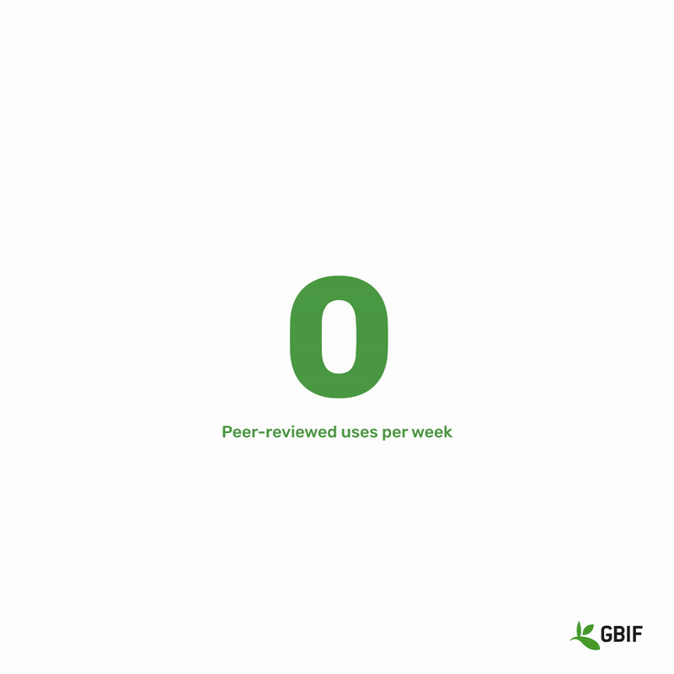
Research and policy
GBIF empowers its community of users to unlock new insights, enabling ground-breaking scientific studies and facilitating evidence-based policy decision-making.

Slide 7
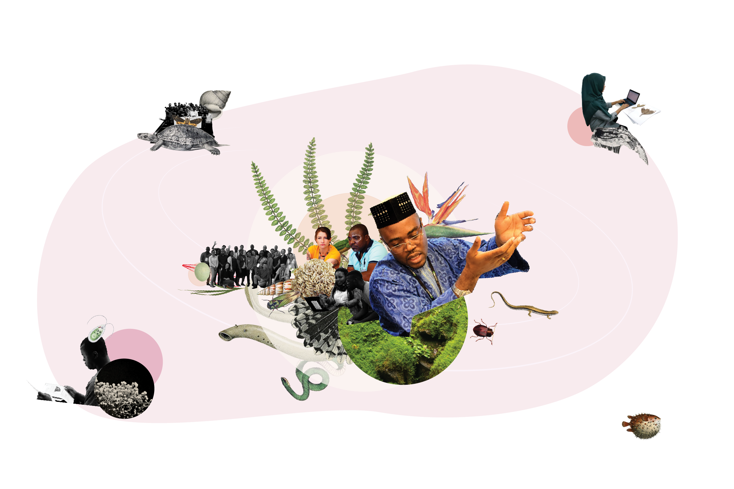
Capacity enhancement
By focusing on people, GBIF recognises that the success of data sharing and conservation efforts relies on individuals' skills, knowledge, and engagement at various levels.

Slide 8
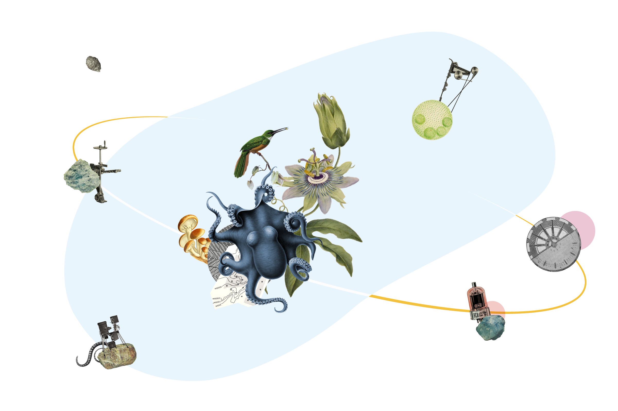
Shared infrastructure
By embracing a hosted framework, GBIF's infrastructure democratises access to biodiversity data, promotes collaboration, facilitates data harmonisation, and fosters innovative research.

Slide 9

Shared infrastructure
“the most comprehensive, openly available, application-agnostic (most unbiased), easiest-to-use, and modern access point to known digital species occurrence data.”
Committee on Data of the International Science Council (CODATA)

